Slide 1
Maryland R.A.P.I.D Regional Automated Property Information Database www.md-bmc.rpdss.com

Slide 2
2011 Property Crimes
Nationwide 534,704 arrests were for violent crimes, and 1,639,883 were made for property crimes.
Arrests second only to drug abuse violations
Larceny-theft estimated at 1,264,986

Slide 3
How does RAPID work?
Dealers Input
Pawn P/M
Secondhand
Junk/ Scrap
ADRS
NCIC
Twice/ Daily
Hits reviewed by Global/System/ County Administrator
Conducts Follow up
RAPID
Business Watch International
(BWI)
User/ Law Enforcement

Slide 4
RAPID Usage
Information is Law Enforcement Sensitive
Full time LE in good standing and conduct criminal investigations
Data can not be used for personal use or gain
Divorce
Shopping
Check on Neighbors or Friends

Slide 5
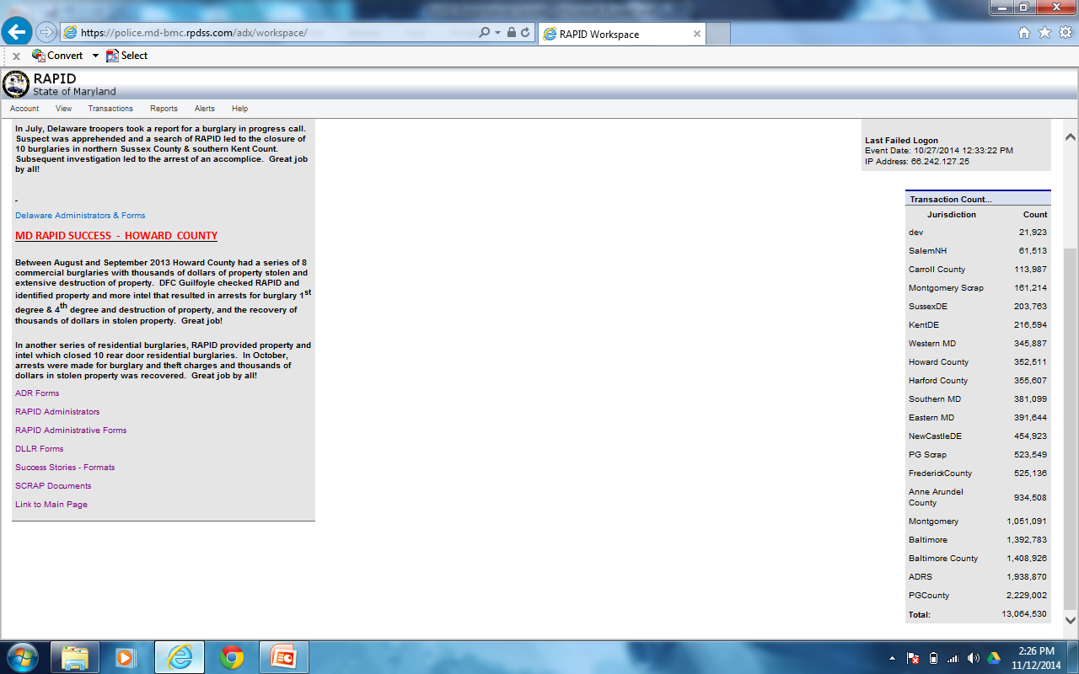
RAPID Home Page
www.md-bmc.rpdss.com

Slide 6
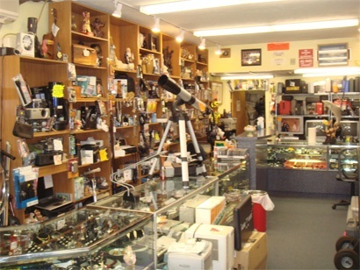
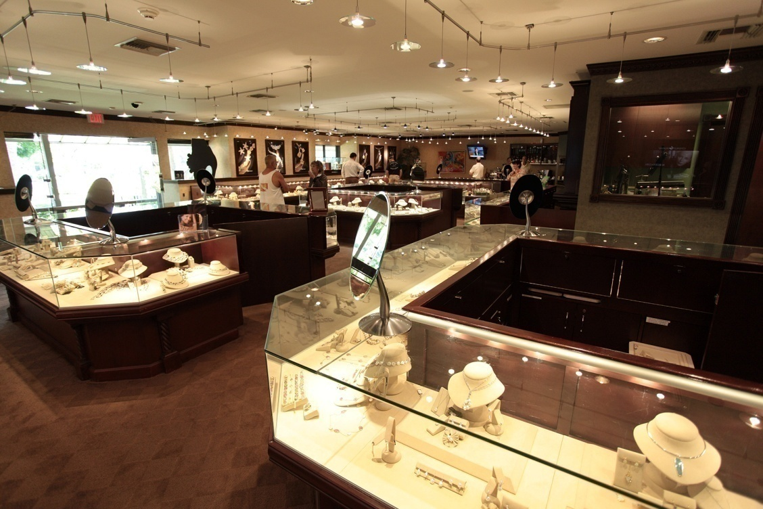
Business Regulation Article Title 12
Pawn Shops
Jewelers, Jewelry Repair Shops, Secondhand, Hair Salon, Auctioneers, Flea Market
Requires Electronic Reporting

Slide 7
Dealer Report Content
Date and time
Name, DOB, ID Number, Physical Description of the seller
Signature of seller and buyer (Written Record)
Type of Item
Make, Model & Serial number of item, along with any identifiers
Full description of precious metal item, including weight, stones and metal content and markings
Price (consideration) paid

Slide 8
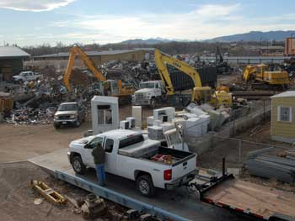
Business Regulation Article Title 17 Subtitle 10
Junk Dealers
Scrap Metal Processers

Slide 9
Reporting Content
The date and time of purchase
A description of the junk or scrap metal
If payment is based on weight, the weight the amount paid or other consideration
License plate number of any vehicle used by the seller
Name and address of seller
Date of birth and driver’s license number or ID from a valid state–issued photo that provides a physical description of the individual, including the sex, race, age, height, and weight
An electronic scan or photocopy of the valid state–issued photo id used during the transaction

Slide 10
Transportation Article Title 15 and 25
Automotive Dismantler Recyclers and Scrap Processers (ADRS)

Slide 11
Dealer Reporting Requirements
Accurate and complete record of ALL vehicles to include:
Name and address of person scrapping
Date acquired
Document of ownership
Other info as required by MVA
By close of business the next business day
Immediately after report, may dismantle or scrap
Vehicle with salvage certificates are exempt from reporting

Slide 12
Transfer of a Vehicle with the Ownership Document
Vehicle presented to ADR
Certificate of Title is executed
Entered electronically into the Database
Vehicle then Scrapped, Dismantled or Re-titled

Slide 13
ADR Notification Requirements
Vehicles without an ownership document the ADR will:
Obtain an Affidavit of Ownership or Lawful Possession at the time of the transfer
Must notify last registered owner
Allow owner a process to recover vehicle

Slide 14
Maryland RAPID 2013 Property Located Value
Jewelry - $518,444
Scrap - $65,164
Vehicles - $36,000
Guns - $46,860

Slide 15
RAPID Past Years
Year | Closed | Arrest | Recovered
2010 | 515 | 490 | $5,197,168
2011 | 882 | 642 | $3,095,693
2012 | 2191 | 1321 | $4,867,733
2013 | 2392 | 1471 | $5,121,061
Total Estimated Recovery $22,245,696.76
2014 - $2,196,218.05 came from one case

Slide 16
MSP RAPID Contacts
F/Sgt. Brian Gill (Program Manager) –
(443)687-0480
brian.gill@maryland.gov
Sgt. Scott Lantz (Eastern Compliance) –
(410)387-3364
scott.lantz@maryland.gov
Maureen Walter (Global Administrator) –
(443)986-1455
maureen.walter@maryland.gov
Capt. Adam Stachurski –
(443)677-7472
adam.stachurski@maryland.gov

Slide 17
Resources
mgaleg.maryland.gov
www.dsd.state.md.us

